Slide 1

Doing Business with the National Nuclear Security Administration
Barbara Stearrett, Director, Office of Acquisition Management
Gary Lyttek, NNSA Business Source Manager

Slide 2
Doing Business with NNSA
Our Mission
Management and security of the nation’s nuclear weapons, nuclear nonproliferation, and naval reactor programs. NNSA responds to nuclear and radiological emergencies in the United States and abroad. Additionally, NNSA federal agents provide safe and secure transportation of nuclear weapons and components and special nuclear materials along with other missions supporting the national security.
Our Small Business Vision
Provide NNSA’s programs with only the highest quality, technically superior, and competitively-priced small business suppliers.
Notes:
Defense applications of nuclear energy
Mature small businesses

Slide 3

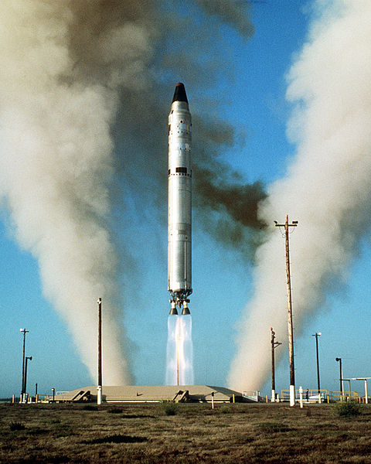
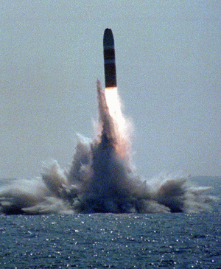
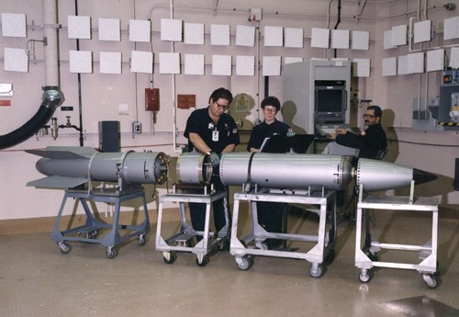
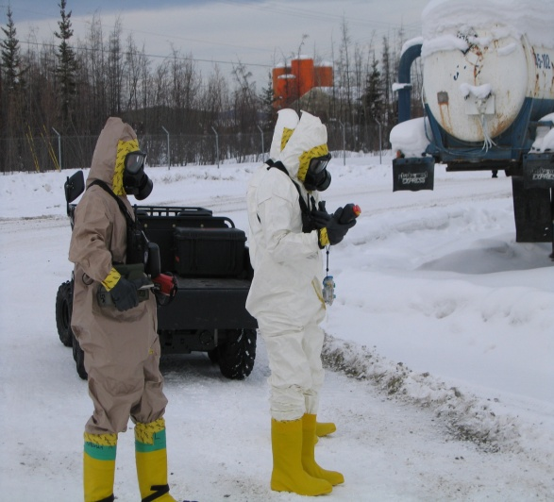
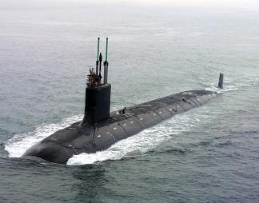
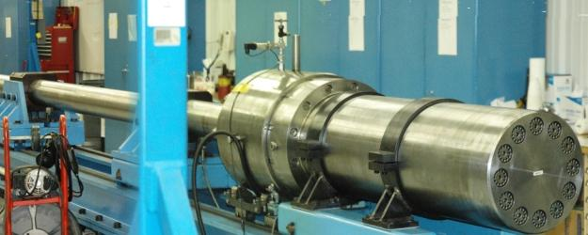
Vital and Urgent Mission
Stockpile Stewardship
Nuclear Nonproliferation
Nuclear Emergency Operations
Naval Nuclear Propulsion
Nuclear Counterterrorism

Slide 4
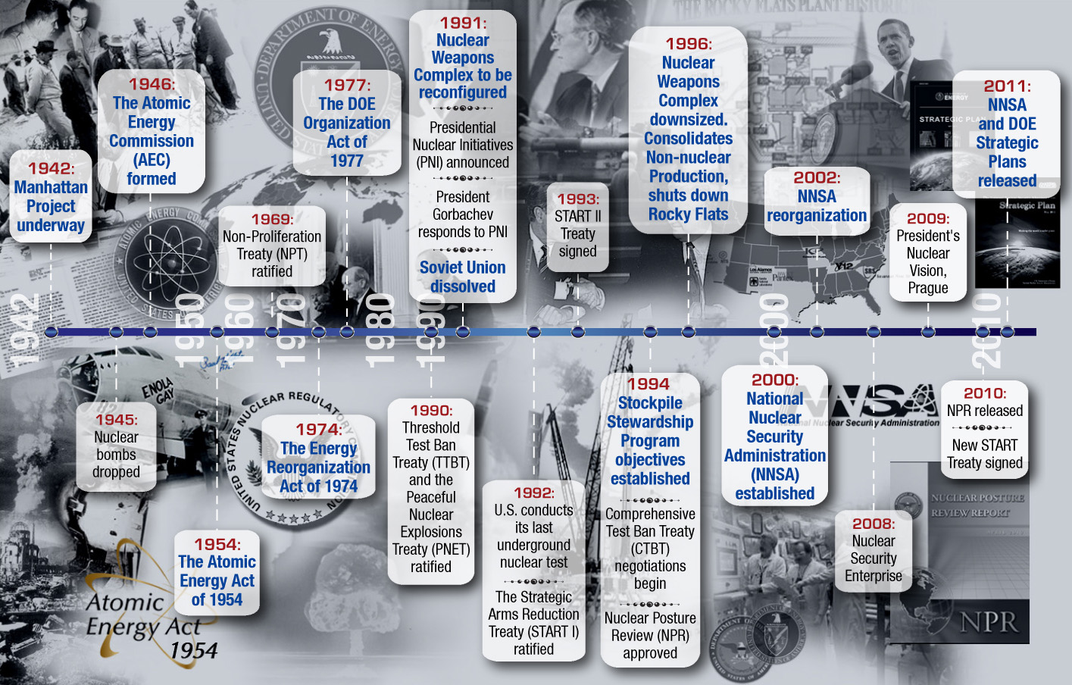
Rich Origin, History, and Evolution
Notes:
“In 2000, the National Nuclear Security Administration (NNSA) was established as a semi-autonomous
agency within the DOE in response to a Congressional mandate to reinvigorate the security posture
throughout the nuclear weapons program and to reaffirm the Nation’s commitment to maintaining the
nuclear deterrence capabilities of the United States. NNSA was chartered as a distinct organization
within the Department to better focus management attention on enhanced security, proactive
management practices, and mission focus within the Department’s defense programs. The Department
performs its national security missions through NNSA.”
NNSA Strategic Plan 2004

Slide 5
FY 2014 Focus Areas
Reduce Nuclear Dangers by securing all vulnerable nuclear materials worldwide; strengthening the nonproliferation regime; and maintaining emergency response, counterterrorism and counterproliferation capabilities;
Manage the Nuclear Weapons Stockpile by completing life extension programs and through robust surveillance and assessment activities, both enabled by investments in the science, technology, and engineering base;
Advance Naval Nuclear Propulsion by supporting the existing nuclear-powered fleet; developing the next generation reactor plant technology for the replacement to the Ohio-class submarine; and replacing and refueling the land-based prototype;
Modernize the NNSA Infrastructure to ensure that the core capabilities are in place to meet mission requirements for the long-term and to create a 21st century Nuclear Security Enterprise;
Strengthen the Science, Technology and Engineering Base that underpin current mission needs and to deal with broader national security challenges for the country; and
Drive an Integrated and Effective Enterprise through the application of improved governance and business models and the recruitment and retention of highly talented Federal nuclear security professionals.
5
Notes:
Small business usage

Slide 6
NNSA Operations
Semi-Autonomous Organization
Unique Procurement Authority
FY 2013 Est. Procurement Base: ~$10.2 B
Management & Operating Contractors (M&O’s) fulfill mission work (FY 2013 – 87% of funding)
Majority of small business opportunities are with our M&O contractors (FY 2013 - $1.5 B)
FY 2013 Federal Small Business Obligations: Over $230 M
Notes:
Check our subcontracting stats

Slide 7
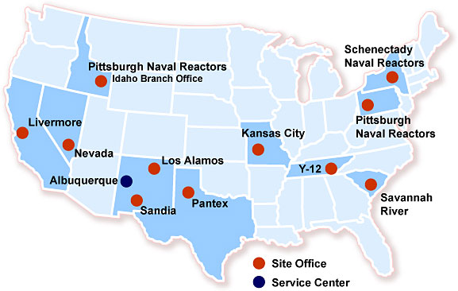
NNSA’s Sites

Slide 8
NNSA Appropriations History FY 2001 – FY 2014
* Starting in FY 2014, Nuclear Counterterrorism Incident Response transferred from Weapons Activities to Defense Nuclear Nonproliferation.

Slide 9
FY 2014 Budget Request – $11.7 Billion
9

Slide 10
NNSA Site Funding Estimates FY 2014 Congressional Budget ($ in millions)
Site | FY 2012 Current | FY 2013 CR | FY 2014 Request | $ Change | % Change
Los Alamos National Laboratory | 1,668.4 | 1,489.5 | 1633.5 | +144.0 | +9.7
Lawrence Livermore National Laboratory | 1,213.7 | 1,088.1 | 1,085.0 | -3.1 | -0.3
Sandia National Laboratories | 1,473.7 | 1,648.9 | 1,670.1 | +21.2 | +1.3
Nevada National Security Site | 311.3 | 323.6 | 353.7 | +30.1 | +9.3
Kansas City Plant | 500.0 | 535.2 | 579.0 | +43.8 | +8.2
Y-12 National Security Complex | 1,027.7 | 1,160.1 | 1,194.3 | +34.2 | +3.0
Pantex Plant | 631.1 | 590.6 | 604.1 | +13.5 | +2.3
Savannah River Site | 821.0 | 862.7 | 681.4 | -181.3 | -21.0

Slide 11
NNSA & Small Business
Policies:
NNSA is committed to providing maximum practicable contracting opportunities to small businesses for goods and services needed to support program and mission accomplishment.
All non-Management & Operating (M&O) contract actions, shall be reserved for small businesses. Non-M&O contract awards to large businesses require an approved Small Business Waiver
Practices:
Senior Management Small Business Goals
Negotiated Annually/Adding to Performance Standards
SBA Partnership – Review new actions over $150K
Small Business Waivers - $150K & $3M
* Opportunity forecasts are subject to change at the discretion of the Contracting Officer

Slide 12
NNSA & Small Business
FY’13 Results:
76 percent of new awards – Small Business
New Blanket Purchase Agreements
Technical & Engineering (Est. Usage: $300M)
Eight Small business-led Teams
Fifty-one team members
Privity of Contract: Any team member can be a Task Lead
Direct Government Past Performance
1st Year-end Estimate: 26 Orders valued @ $105M
Administrative (Est. Usage: $150M)
Forecasted award date: Within 30 days
Full Small Business Set-aside – estimated five or more teams
Dozens of team members
Over $1.7 billion in Small Business Obligations!
* Opportunity forecasts are subject to change at the discretion of the Contracting Officer

Slide 13
What’s Next?
FY’14 Initiatives:
Socio-Economic Set-asides
SDVOSB
HUBZone
WOSB
8(a) Program
Construction Program
GPP vs. Capital Construction
Vendor Base
Bonding

Slide 14
QUESTIONS?

Slide 15
Doing Business with the National Nuclear Security Administration
Barbara Stearrett, Director, Office of Acquisition Management
Gary Lyttek, NNSA Business Source Manager

Slide 16
Upcoming Opportunities Los Alamos National Laboratory
SUBCONTRACTING - NM
Decontamination and demolition work at LANL’s TA-35 & TA-48 sites
NAICS TBD
Type of Action Open
Estimated Dollar Range $230K
Forecasted RFP Date TBD
Storm Water Controls Project to protect LANL’s Firing Site from flooding
NAICS TBD
Type of Action Open
Estimated Dollar Range $1.5M
Forecasted RFP Date TBD
Contact Info: Glenn Clemons
gclemons@lanl.gov
(505) 606-0740
* Opportunity forecasts are subject to change at the discretion of the Contracting Officer
Notes:
UPF will consolidate all EU operations into a single, modern facility with state-of-the-art technologies, safeguards, and security concepts and strategies.
Current status (other than design):
Recently received approval for Site Readiness (Roadwork/Excacation)
Site Readiness to be performed by the U.S. Army Corp of Engineers
USACE Forecast can be found on FEDBIZOPS (www.fbo.gov)
UPF’s diverse Uranium missions include: stockpile refurbishment, weapons surveillance, reactor fuel for Medical Isotopes, and disassembly and dismantlement.
UPF Procurements will include: (1) Engineered Equipment, (2) Custom Fabrication, (3) Standard Materials & Major Bulk commodities, and (4) Minor Bulks & Consumables. (Small business opportunities may be more predominate in Standard Materials & Major Bulks / Minor Bulks &n Consumables).

Slide 17
Upcoming Opportunity Uranium Processing Facility – UPF
SUBCONTRACTING - TN
UPF – Provides safe, secure and reliable enriched uranium operations, replacing antiquated WWII-era facilities
Estimated Cost Range $4.2B - $6.5B
Subcontracting Opportunities ~ $1.8B - $2.5B
Workforce: Current (600); Peak (1500)
Current Status Design
Estimated Completion ~ FY 2025
* Opportunity forecasts are subject to change at the discretion of the Contracting Officer
Notes:
UPF will consolidate all EU operations into a single, modern facility with state-of-the-art technologies, safeguards, and security concepts and strategies.
Current status (other than design):
Recently received approval for Site Readiness (Roadwork/Excacation)
Site Readiness to be performed by the U.S. Army Corp of Engineers
USACE Forecast can be found on FEDBIZOPS (www.fbo.gov)
UPF’s diverse Uranium missions include: stockpile refurbishment, weapons surveillance, reactor fuel for Medical Isotopes, and disassembly and dismantlement.
UPF Procurements will include: (1) Engineered Equipment, (2) Custom Fabrication, (3) Standard Materials & Major Bulk commodities, and (4) Minor Bulks & Consumables. (Small business opportunities may be more predominate in Standard Materials & Major Bulks / Minor Bulks &n Consumables).

Slide 18
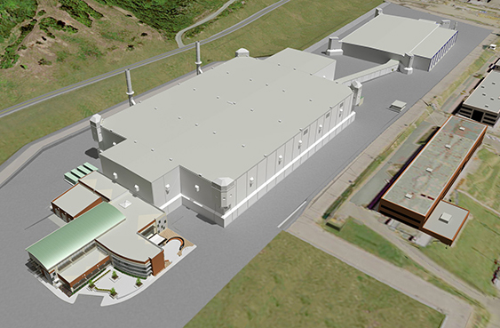
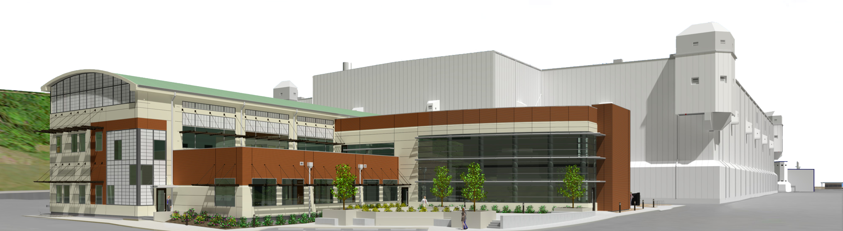
UPF
Existing EU facilities:
Do not meet modern nuclear safety or security standards
Are experiencing age-related degradation, costing more to maintain and increasing safety risk
UPF
Sustains long-term U.S. uranium manufacturing capability
Provides significant safety and security improvements
Reduces long-term operating costs
Notes:
UPF will consolidate all enriched uranium operations into a facility 35% the size of the current space. This consolidation will shrink the site’s high security area by 90% and lower operational costs and energy consumption.
UPF will upgrade process technologies and improve worker safety, and will allow us to meet modern missions more efficiently.
As construction begins, we will bring on board more staff and sign contracts totaling about $2 billion for equipment and materials.
Will be the largest single construction project ever in the state of Tennessee.

Slide 19
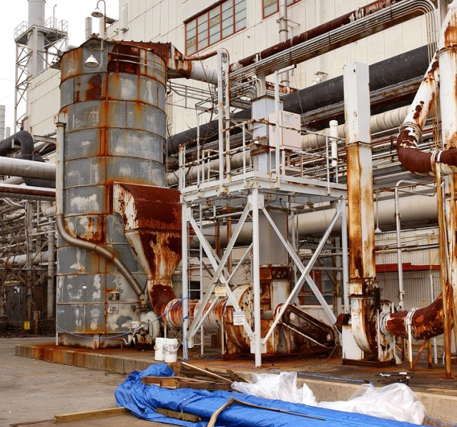
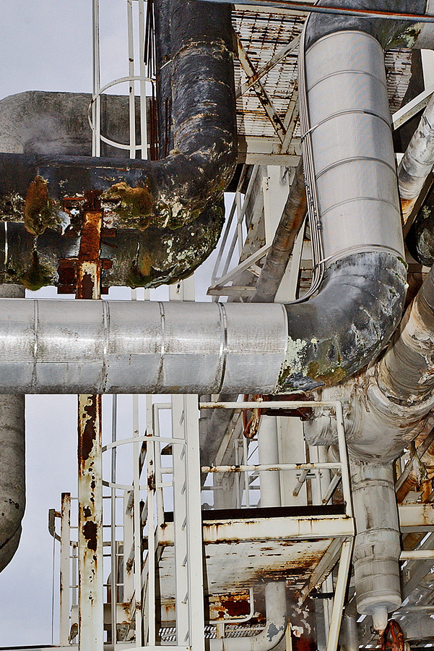
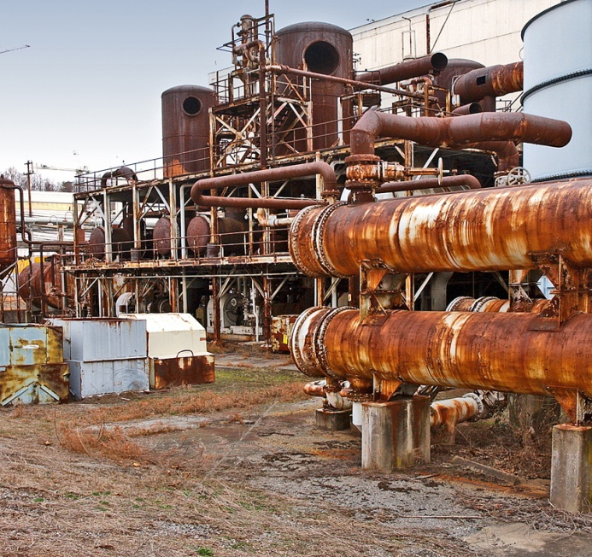
Y-12 Transformation — Why It’s Important
Notes:
Why transformation? Y-12’s facilities have outlasted their originally estimated lifespan.
Aged site facilities, designed and built 1940s–1970s (nearly 1.9 million square feet in aging mission-critical facilities )
Built quickly during the Manhattan Project
Soft construction: clay tile, wood, cinder block (Other issues with contiguous utilities; water/sewer; electric; brine coolant; communications)
Not process-specified designed
Approximately $141 million in deferred maintenance costs each year
Current impact: security; operational efficiencies (4%–25% utilization); maintenance and reliability

Slide 20

Upcoming Bid Requests
PURCHASE ORDERS
SUBCONTRACTS
Electric Tube Conversion Furnaces (Q)
Hydraulic Break/Shear Press (RS)
Electric Oxide Furnaces (Q)
Bottom Loading Furnaces (Q)
Centrifuges (Q)
Calciner (Q)
Vacuum Annealing Furnaces (Q)
Rebar Detail/Supply/Fabrication (Q)
Structural Steel (Q)
Embedments (Q)
Concrete Formwork (C)
Office Furniture (C)
Process & Specialty Skids (Q)
Gloveboxes/Integration (Q)
Pipe Hangers (Q)
Pipe Spools (Q)
Access Doors (C )
Horizontal Jack & Bore (C)
Tower Cranes (C)
RUBB Tent Upgrade (C)
Concrete Testing (Q)
Plug & Abandon Monitoring Wells (C)
Surveying Services (Q)
Standard Penetration Testing (Q)
Construction Labor & Equipment (C)
Gas Storage Building (C )
Modular Office Facilities (C )
Admin Building (C )
Process Support Facilities (C )
Welding Management (Q)
Fireproofing (Q )
Architectural Finishes (C )
HVAC Fab / Install (Q )
Fire Protection (Q)
Cooling Towers (C )
Firewater Pump Houses ( C)
Substation (C )
Insulation (Q)
Lightning Protection (C)
Chillers (C)
Paving (C)
Roofing (C)
Painting/Coatings (C)
Siding (C)
Fire Detection (Q)
To register or for more information on UPF, please contact us at: 865-574-0079 or upfprocurement@y12.doe.gov
Q – Nuclear Quality NQA-1 2008 w/ 2009 Addendum
RS – Risk Significant Commercial Produces (ISO 9000)
C – Industrial Commercial Products/Services

Slide 21
Uranium Processing Facility
Interested in Becoming a UPF Supplier?
GET LISTED IN THE UPF SUPPLIER DIRECTORY 865-574-0079 http://upfprocurement@y12.doe.gov | PROCUREMENT CONTACTS EQUIPMENT Elaine Najmola 865-241-0818 najmolame@y12.doe.gov
REGISTER http://www.supplier.bechtel.com | CONSTRUCTION Ralph Helton 865-576-9097 heltonrs1@y12.doe.gov
WATCH FOR LATEST PROCUREMENTS Y-12 website: http://www.y12.doe.gov Fed Biz Opp: https://www.fbo.gov | Y-12 SMALL BUSINESS PROGRAM Lisa Copeland 865-576-2090 copelandl@y12.doe.gov http://www.y12.doe.gov/suppliers/socioeconomic-programs
Notes:
It is very important that suppliers monitor the Y-12 Procurement Forecast for upcoming major procurements.
UPF/Y-12 also may utilize FEDBIZOPS for “Request for Information” and “Expressions of Interest” for upcoming major procurements.

Slide 22
Upcoming Opportunity Training - OST Federal Prime (NA004-14-0004)
Office of Secure Transportation
Estimated Value $30M - $50M
Period of Performance 5 Years
Incumbent ITP, LLC
Acquisition Approach SBSA
Estimated RFP Release 2nd Qtr. FY 2014
NAICS Code 561210 ($35.5M)
Training and related services to support Material Handlers for the Office of Secure Transportation. The contractor furnishes all facilities, equipment, material to provide support services to analyze, design, develop, plan, execute mission operations and training administrative support and evaluate training and equip Federal Agents (FA’s) and Agent Candidates to support the OST mission. (http://nnsa.energy.gov/aboutus/ourprograms/defenseprograms/securetransportation)
Contact Greg Gonzales for more details (505) 845-5420
* Opportunity forecasts are subject to change at the discretion of the Contracting Officer

Slide 23
Upcoming Opportunity NEPA Environmental Services
Estimated Value ~$91M
Period of Performance 5 years
Acquisition Approach Schedule 899 - Small Business criterion: Primary
Estimated RFP Release 2nd Qtr. FY 2014
NAICS Code 541620 ($14M)
RFQ Release Within weeks
Provide Environmental Services across the NNSA and DOE enterprise including the preparation of environmental assessments, environmental impact statements, & other supporting reports.
Point of Contact: Greg Gonzales/NNSA (505) 845-5420
* Opportunity forecasts are subject to change at the discretion of the Contracting Officer

Slide 24
Upcoming Opportunity Environmental Remediation Services
Location: Nevada National Security Site
Estimated Value Over $100M
Period of Performance 5 years
Acquisition Approach SBSA
Estimated RFP Release 2nd Qtr. FY 2014
NAICS Code 562910 (500 employee)
Environmental characterization and remediation services at designated corrective actions sites. Program Management & public involvement support; site characterization & assessments; remedial action & waste acceptance services
Point of Contact: Greg Gonzales/NNSA (505) 845-5420
* Opportunity forecasts are subject to change at the discretion of the Contracting Officer

Slide 25
Upcoming Opportunity Consolidated Mission IT. & Cyber
(DE-SOL-0005569/NA001-13-0006)
Extensive, Multi-site IT Support Services
Estimated Value Over $200M
Period of Performance 5 Years- Spring 2014
Incumbent Various
Acquisition Approach Schedule 70, BPAs, SBSA
Draft PWS Released (On Fedconnect Now)
RFQ Release December 2013
NAICS Code 541513 ($25.5M)
Includes: General IT Support, Cyber Security, Policy & Governance, plus emerging work. Competition for emerging requirements.
Sites, (including but not limited to):
Washington DC Metro Area
Albuquerque, NM
* Opportunity forecasts are subject to change at the discretion of the Contracting Officer

Slide 26
Acquisition Forecast
NNSA’s Multi-Year Acquisition Forecast
Prime DOE/NNSA Contracting Opportunities
Subcontracting Opportunities Available from M&O Contractors
Web URL
https://hqlnc.doe.gov/support/nnsaforecast.nsf
http://hqlnc.doe.gov/forecast

Slide 27
Help Us…
Get to know who we are
Growing Contract Sizes
Teaming
Affiliation Rules
Protests
Know the Regulations
Sources Sought
27

Slide 28
Contact Information
Greg Gonzales- Small Business Program Manager - Albuquerque:
U.S. Department of Energy
National Nuclear Security Administration
P.O. Box 5400
Albuquerque, NM 87115
(505) 845-5420
gregory.gonzales@nnsa.doe.gov
Gary Lyttek – NNSA Business Source Manager - Headquarters:
U.S. Department of Energy
1000 Independence Ave. SW
Washington, DC 20585
ATTN: NA-APM-10
(202) 586-8304
gary.lyttek@nnsa.doe.gov

